Slide 1
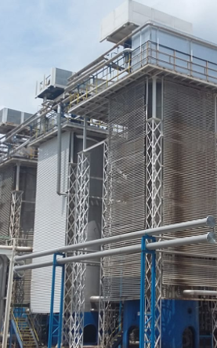
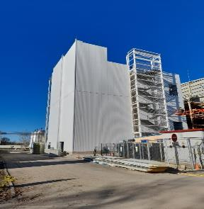
Scheme of the biological production process
Raw materials
Intermediate processes
Final products
 | Derivatives | Fusidic acid Sodium fusidate Diethanolamine fusidate
Fusidic raw
 | Salts | Ethylsuccinate Stearate Stolate Propionate
Erythromycin base
 | Derivatives | Azithromycin Clarithromycin
Taylor-made production
Sugar
Fermentation
Extraction
Oil
Vegetable proteins
Mineral salts
Oxygen

